Slide 1
Indoor WiFi simulator
Aleksander Parelo

Slide 2
Idea
Simulate WiFi signal in an indoor environment
Show the results as a heatmap, that can be used to plan WiFi router placement.

Slide 3

Helmholtz equation
$\left(∇^{2}E+ \frac{k^{2}}{n^{2}}E\right)=$f(x)

Slide 4
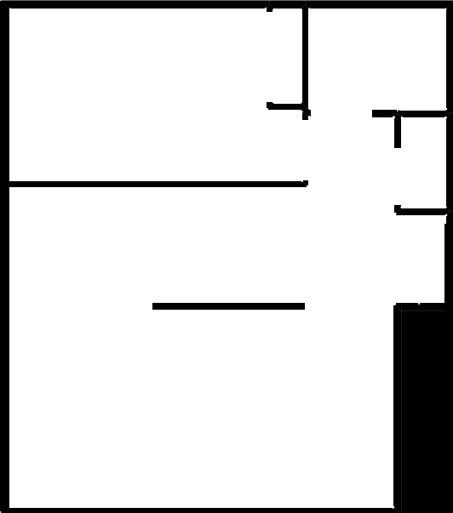
Refractive index map
Divide the image into a grid of MxN squares

Slide 5
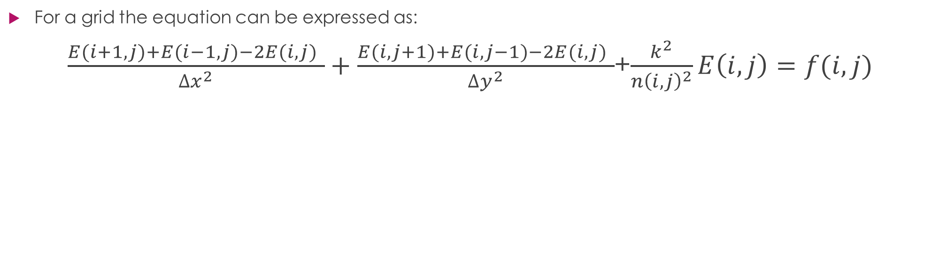
Helmholtz equation over a grid
For a grid the equation can be expressed as:
$\frac{E(i+1,j)+E(i−1,j)−2E(i,j) }{∆x^{2}}+\frac{E(i,j+1)+E(i,j−1)−2E(i,j) }{∆y^{2}}$+$\frac{k^{2}}{{n\left(i,j\right)}^{2}}E\left(i,j\right)=f(i,j)$

Slide 6
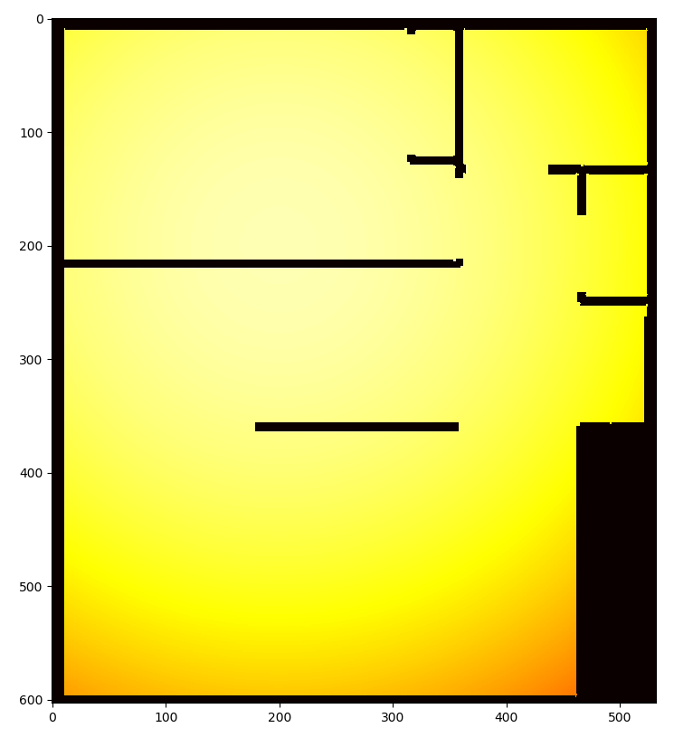
Result

Slide 7
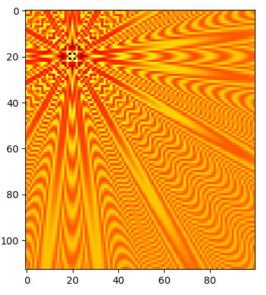
Different approach
Using Bessel equations
Better looking wave shape but couldn’t make it interact with the room

